Slide 1
Intro to Bayesian Hierarchical Modeling
June 11, 2025
UTSSRP
Prof. Gwendolyn Eadie

Slide 2
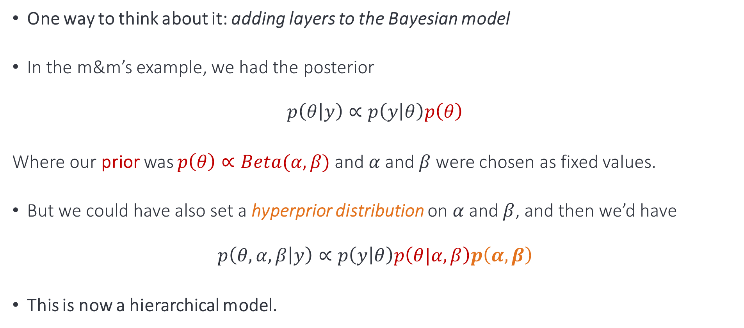
Basics of a Hierarchical Model
One way to think about it: adding layers to the Bayesian model
In the m&m’s example, we had the posterior
$$p\left(θ | y\right)∝p\left(y | θ\right)p\left(θ\right)$$
Where our prior was $p\left(θ\right)∝Beta(α,β)$ and $α$ and $β$ were chosen as fixed values.
But we could have also set a hyperprior distribution on $α$ and $β$, and then we’d have
$$p\left(θ,α,β | y\right)∝p\left(y | θ\right)p\left(θ|α,β\right)p\left(α,β\right)$$
This is now a hierarchical model.

Slide 3
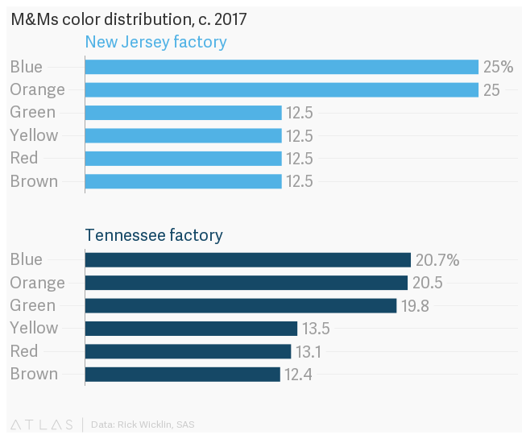
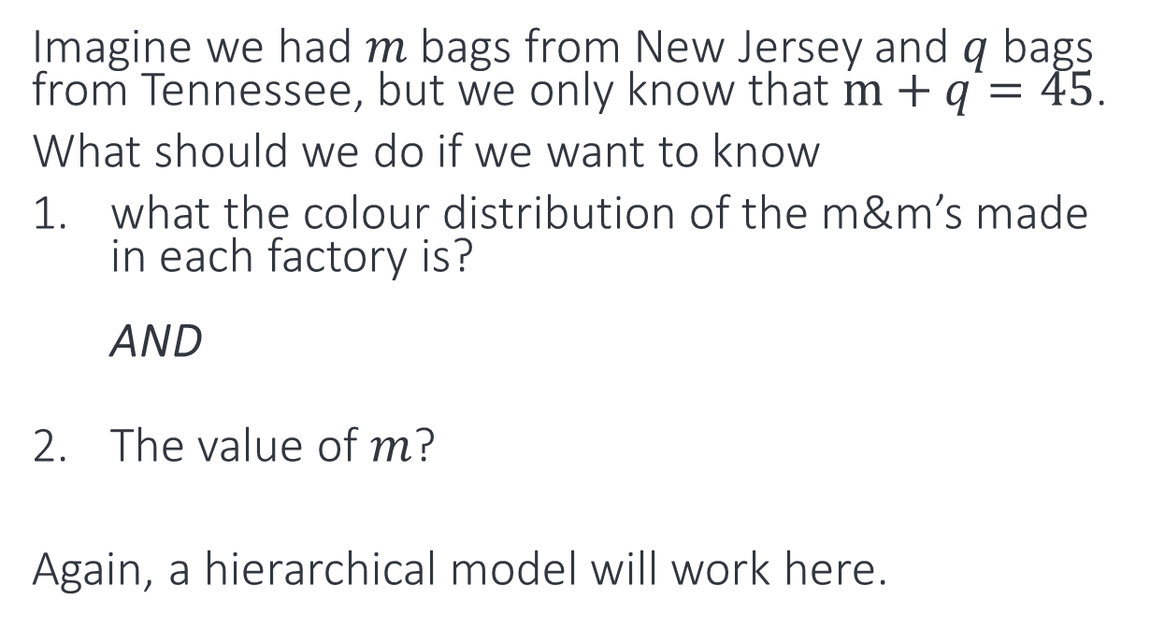
Basics of a Hierarchical Model
Another reason to do hierarchical modeling: want to infer parameters at different levels in the hierarchy, and account for structure in the variation
In N. America, two factories make m&m’s
Imagine we had $m$ bags from New Jersey and $q$ bags from Tennessee, but we only know that $m+q=45$.
What should we do if we want to know
what the colour distribution of the m&m’s made in each factory is? AND
The value of $m$?
Again, a hierarchical model will work here.
3

Slide 4
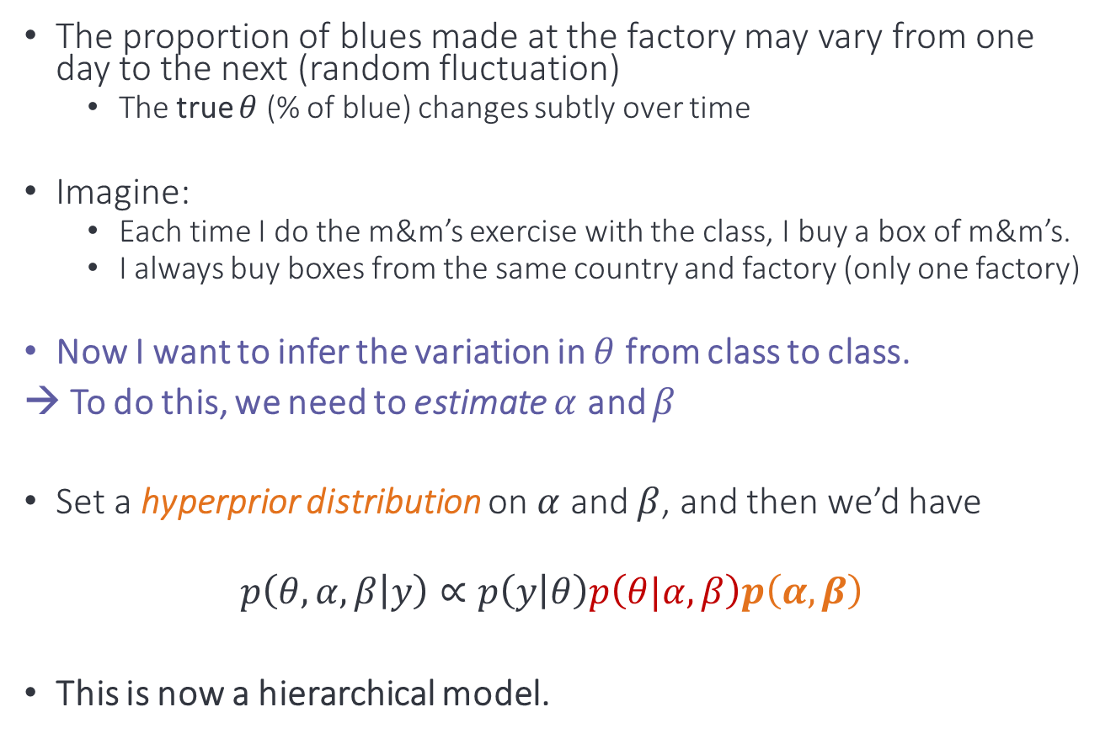
Hierarchical Model Example
The proportion of blues made at the factory may vary from one day to the next (random fluctuation)
The true $θ$ (% of blue) changes subtly over time
Imagine:
Each time I do the m&m’s exercise with the class, I buy a box of m&m’s.
I always buy boxes from the same country and factory (only one factory)
Now I want to infer the variation in $θ$ from class to class.
→ To do this, we need to estimate $α$ and $β$
Set a hyperprior distribution on $α$ and $β$, and then we’d have
$$p\left(θ,α,β | y\right)∝p\left(y | θ\right)p\left(θ|α,β\right)p\left(α,β\right)$$
This is now a hierarchical model.

Slide 5
Examples from Astronomy Research

Slide 6
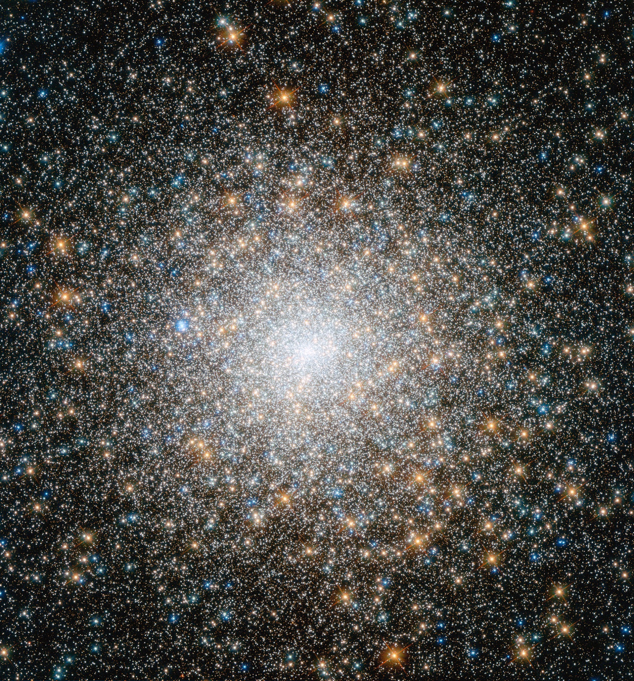
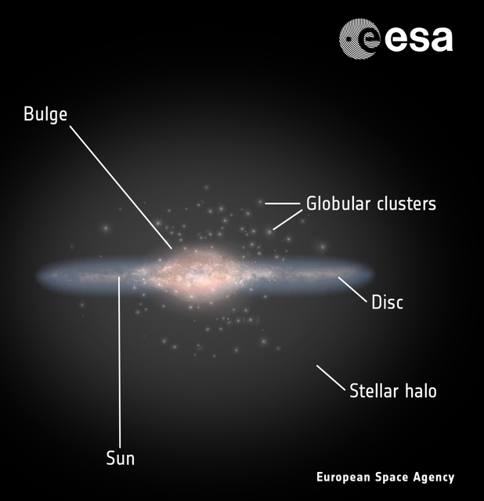
Estimating the mass of the Milky Way
Globular Cluster (GC)
Using hierarchical Bayes and “kinematic tracers”
Sketch of Milky Way

Slide 7
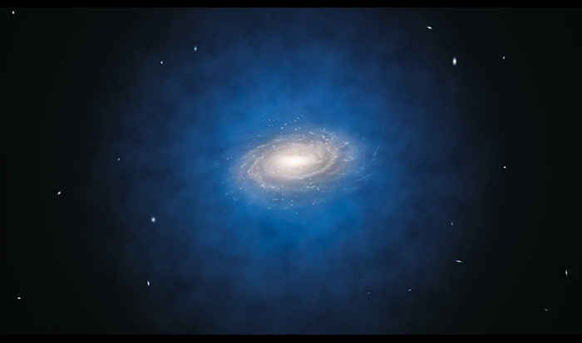
Hierarchical Bayesian Model for MW Mass Estimate
in Pictures
Each GC has Individual parameters:
True position
True velocity
Likelihood
...
Shared population parameters for galaxy:
Spatial density of GCs
Gravitational potential
Velocity anisotropy
Prior
Hyperprior
Hyperparameters:
Bounds for model parameters
Mean and variance for parameters

Slide 8
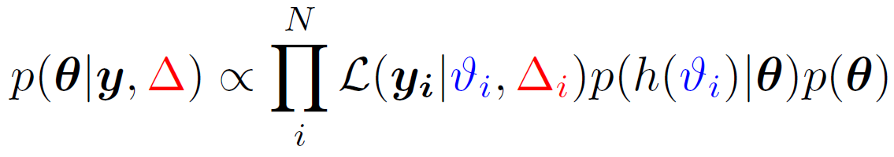
Hierarchical Bayesian Model for MW Mass Estimate
in Math
Posterior Distribution
Likelihood
•
Prior
•
Hyperprior
∝
measurement model
physical model
Priors on model parameters

Slide 9
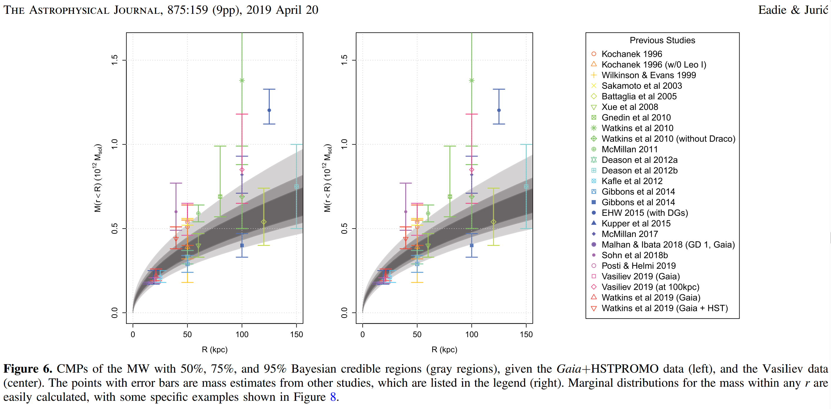
Posterior Distribution is then used to calculate a
cumulative mass profile
with credible regions
Eadie & Juric (2019), ApJ 875:159

Slide 10
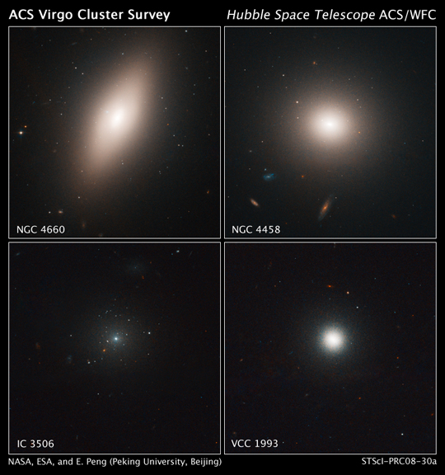
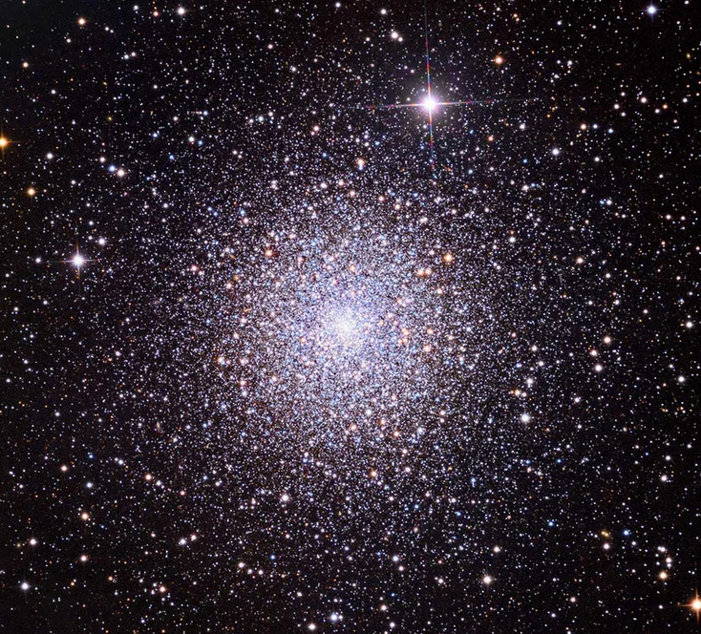
Inferring the relationship between GCs and their host galaxy mass
Using a hierarchical errors-in-variables model

Slide 11
What we observe in the local universe:
Large galaxies have GCs, but some smaller (dwarf) galaxies do not.
In between these extremes, there is a transition.
How large is the transition region?

Slide 12
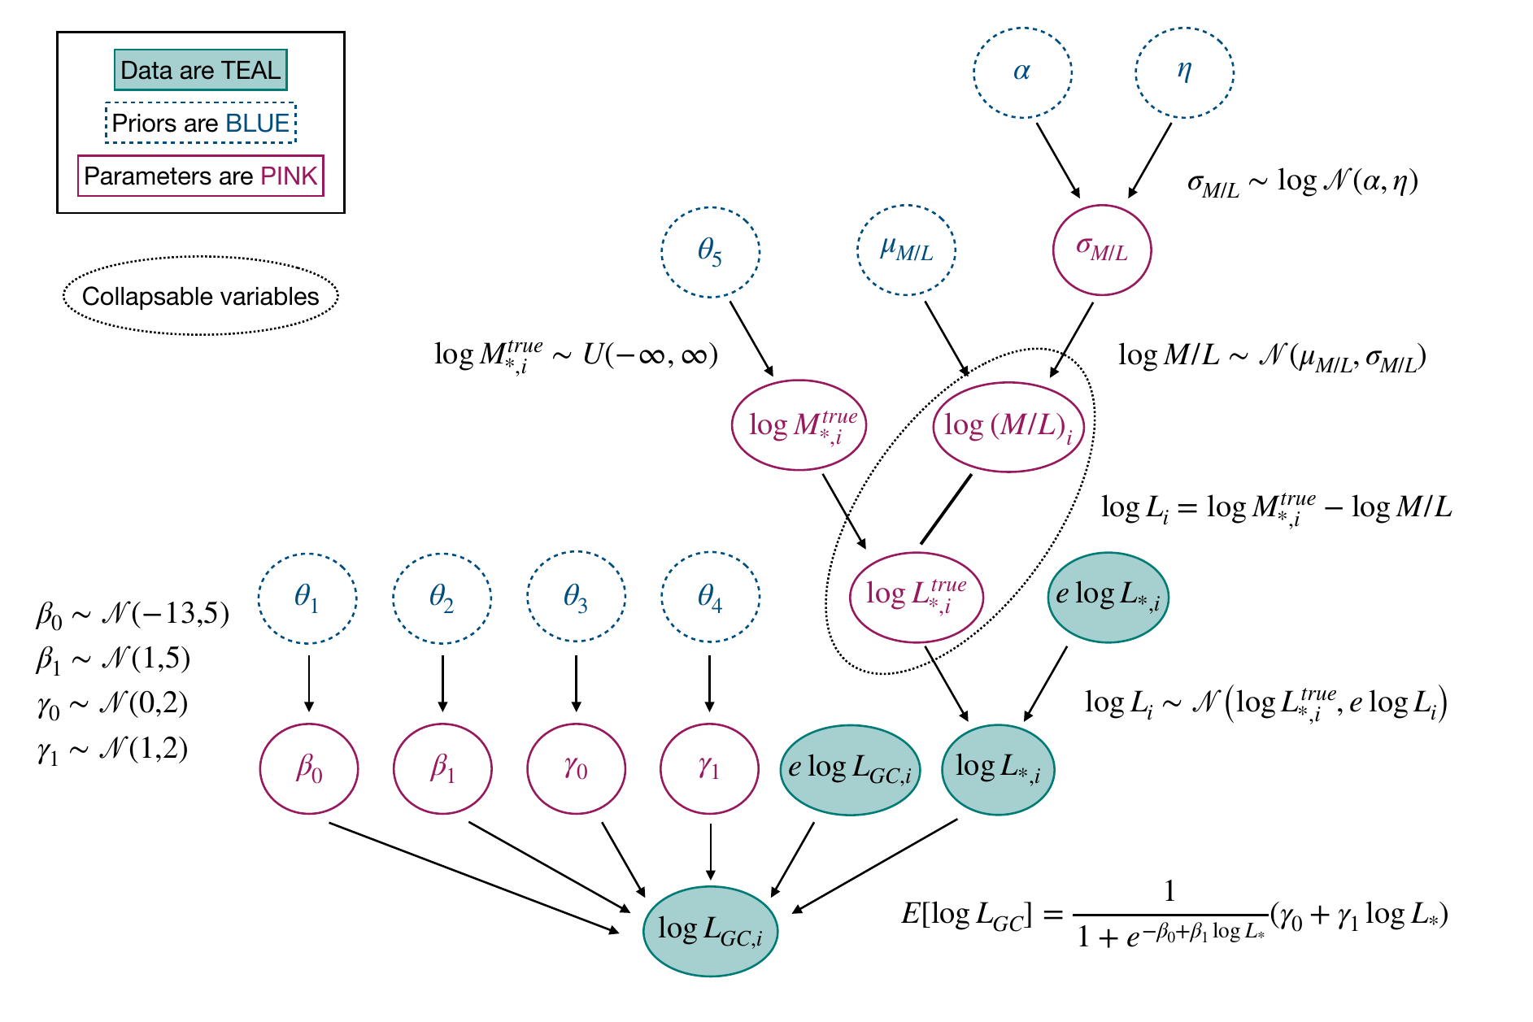

Hierarchical Errors-in-Variables Bayesian Log-Normal Hurdle Model
Sam Berek
PhD Candidate
Berek, Eadie, Speagle, & Harris (2023), ApJ 955(1), 22.

Slide 13
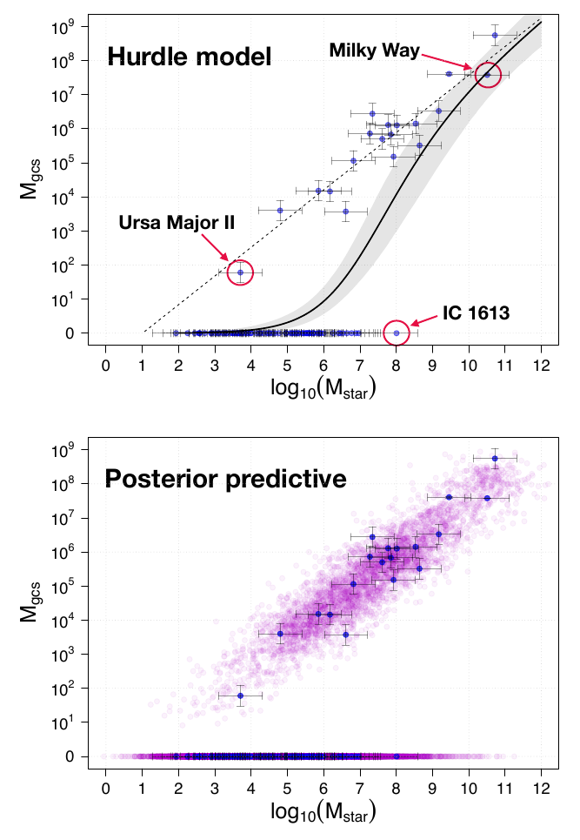
HERBAL model
Sam Berek
PhD Candidate
Berek, Eadie, Speagle, & Harris (2023), ApJ 955(1), 22.

